Slide 1
Feature explainability with Counterfactual
With Autoencoders

Slide 2
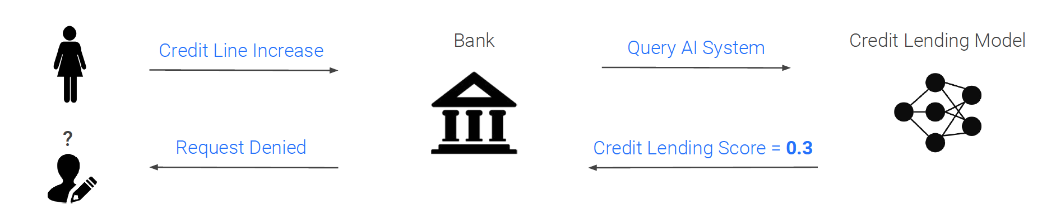
Explainability: reminder
Bank
Credit Lending Model
Credit Line Increase
Query AI system
Request Denied
Credit Lending Score = 0.3

Slide 3
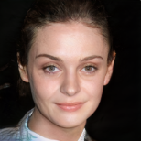
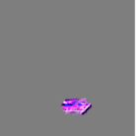
What is Counterfactual?
How do we know this picture shows a smiling woman?
Original image
Explanation 1:
Feature importance

Slide 4
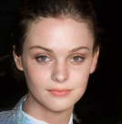
What is Counterfactual?
How do we know this picture shows a smiling woman?
Original image
Explanation 1:
Feature importance
Explanation 2:
Counterfactual

Slide 5




What is Counterfactual?
Applied to a real use case:
Sample and counterfactual have features in common:
Same profession
Close revenues
Close time in same bank
…
BUT:
Counterfactual has a 20% lower debt
Loan accepted
Loan refused

Slide 6
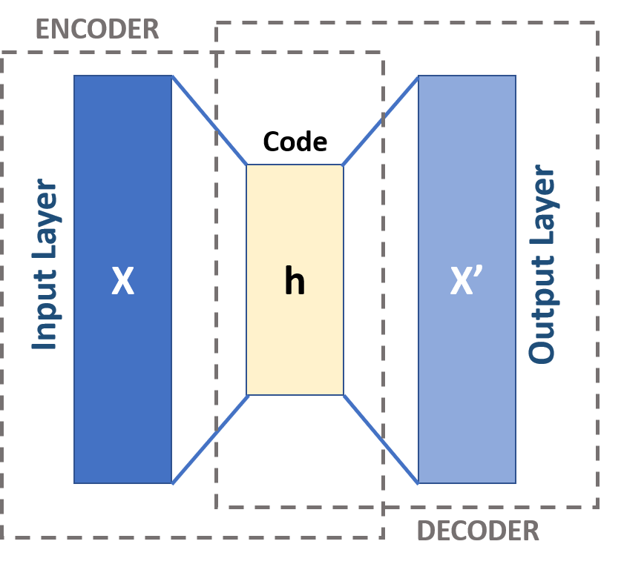
Autoencoders

Slide 7
Autoencoders
Latent Layer

Slide 8
Method
1
Clustering samples in the Latent Layer with an autoencoder
Generating samples from a specific class in the Latent Layer with multivariate_normal
Choosing in the latent layer the closest neighbor from a class K to a sample of class J
Decoding the closest neighbor in the output space with the decoder
2
3
4

Slide 9
Method
1
Clustering samples in the Latent Layer with an autoencoder
Generating samples from a specific class in the Latent Layer with multivariate_normal
Choosing in the latent layer the closest neighbor from a class K to a sample of class J
Decoding the closest neighbor in the output space with the decoder
2
3
4

Slide 10
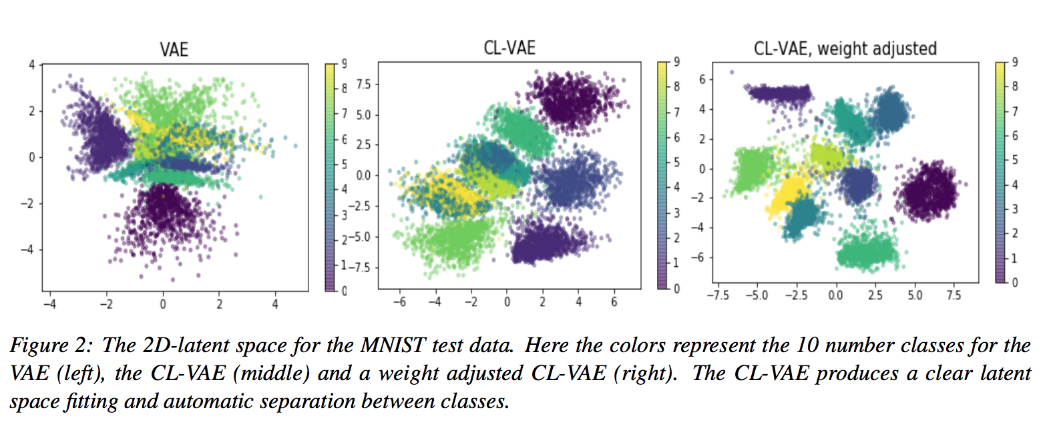

Method
1
Clustering samples in the Latent Layer with an autoencoder
Representation of data in latent space
Bad clustering
Ok clustering
Amazing clustering

Slide 11
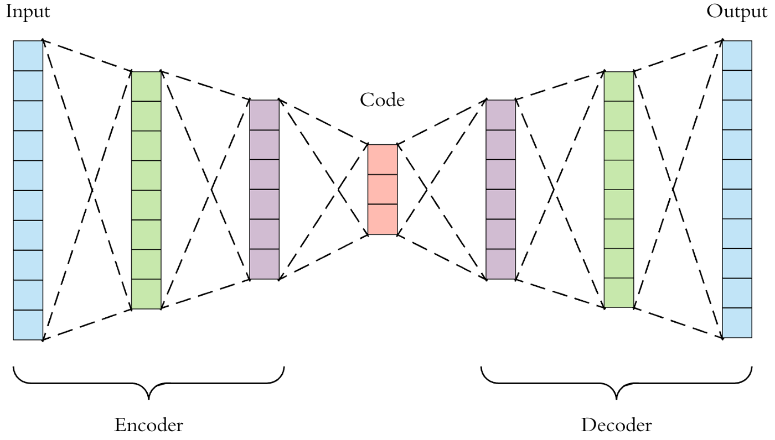
Method
1
Clustering samples in the Latent Layer with an autoencoder

Slide 12
Method
1
Clustering samples in the Latent Layer with an autoencoder
Clustered Layer:
Better cluster all classes

Slide 13
Method
1
Clustering samples in the Latent Layer with an autoencoder
Clustered Layer

Slide 14
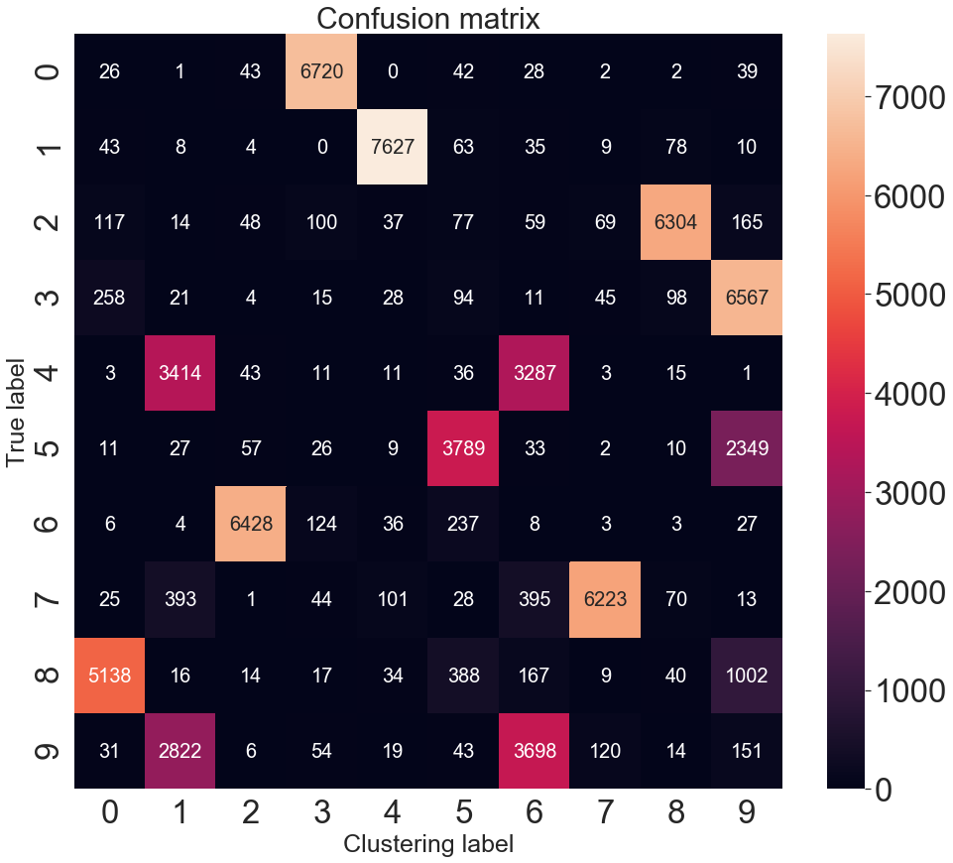
Clustered layer

Slide 15
Method
1
Clustering samples in the Latent Layer with an autoencoder
Generating samples from a specific class in the Latent Layer with multivariate_normal
Choosing in the latent layer the closest neighbor from a class K to a sample of class J
Decoding the closest neighbor in the output space with the decoder
2
3
4

Slide 16
Method
2
Generating samples from a specific class in the Latent Layer with multivariate_normal
Objective: take an initial sample of class 0, and find HOW to make it into a 2
0
2

Slide 17
Method: Generating samples from the expected class
Objective: take an initial sample of class 0, and find HOW to make it into a 2
0
2
np.random.multivariate_normal(mean, covs, size=1000)

Slide 18
Method
1
Clustering samples in the Latent Layer with an autoencoder
Generating samples from a specific class in the Latent Layer with multivariate_normal
Choosing in the latent layer the closest neighbor from a class K to a sample of class J
Decoding the closest neighbor in the output space with the decoder
2
3
4

Slide 19
Method
3
Choosing in the latent layer the closest neighbor from a class K to a sample of class J
YOU ARE HERE

Slide 20
Method
3
Choosing in the latent layer the closest neighbor from a class K to a sample of class J
Initial sample encoded in latent layer
(class 0)
Fake generated samples in latent layer
(class 2)

Slide 21
Method
3
Choosing in the latent layer the closest neighbor from a class K to a sample of class J
Closest Neighbor
Initial sample encoded in latent layer
(class 0)
Fake generated samples in latent layer
(class 2)

Slide 22
Method
1
Clustering samples in the Latent Layer with an autoencoder
Generating samples from a specific class in the Latent Layer with multivariate_normal
Choosing in the latent layer the closest neighbor from a class K to a sample of class J
Decoding the closest neighbor in the output space with the decoder
2
3
4

Slide 23
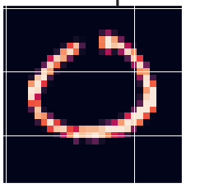
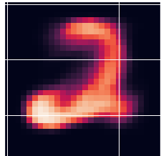
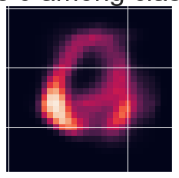
Getting the distribution of a cluster
4
Decoding the closest neighbor in the output space with the decoder
Initial Sample of class 0 in input dimension
Fake generated sample of class 2
after decoding
Closest neighbor of class 2 to our initial sample among fake samples

Slide 24
Getting the distribution of a cluster
4
Decoding the closest neighbor in the output space with the decoder
Initial Sample of class 0
BEFORE encoding
Example of fake generated sample of class 2
AFTER decoding
Closest neighbor of class 2 to our initial sample among fake samples
ENCODING
DECODING
LATENT SPACE:
Find closest neighbor to our sample NO LOAN among fake generated samples of class
LOAN ACCEPTED
Initial Sample of class NO LOAN
BEFORE encoding
Closest neighbor of class LOAN ACCEPTED to our initial sample among fake samples

